Slide 1
Machine Learning for Healthcare
AYESHA SHAFIQUE

Slide 2
Points of todays workshop
Overview
Problem Formulation
Machine learning Solution
Model Interpretation
Takeaways

Slide 3
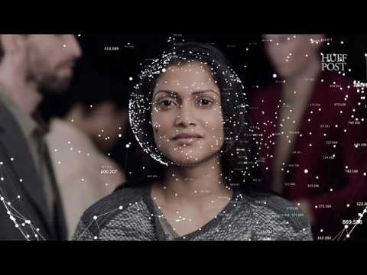

Slide 4
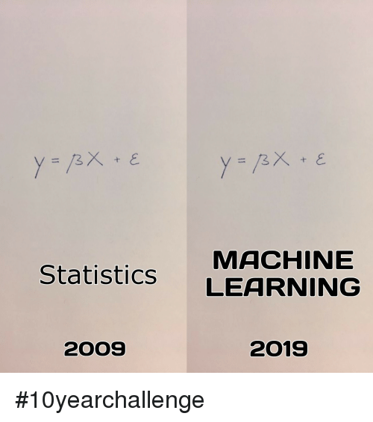
#10 Year Challenge

Slide 5
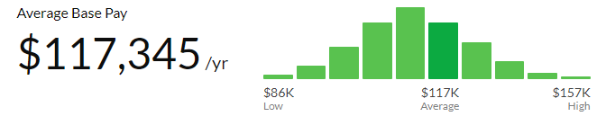
How much does a data scientist earn?
Stats via glassdoor.com

Slide 6
How you can use ML for healthcare?

Slide 7
Case Study
Predicting diabetes using Machine Learning

Slide 8
Model Interpretation
SHAPELY - Prescriptive Maintenance of adverse outcomes

Slide 9
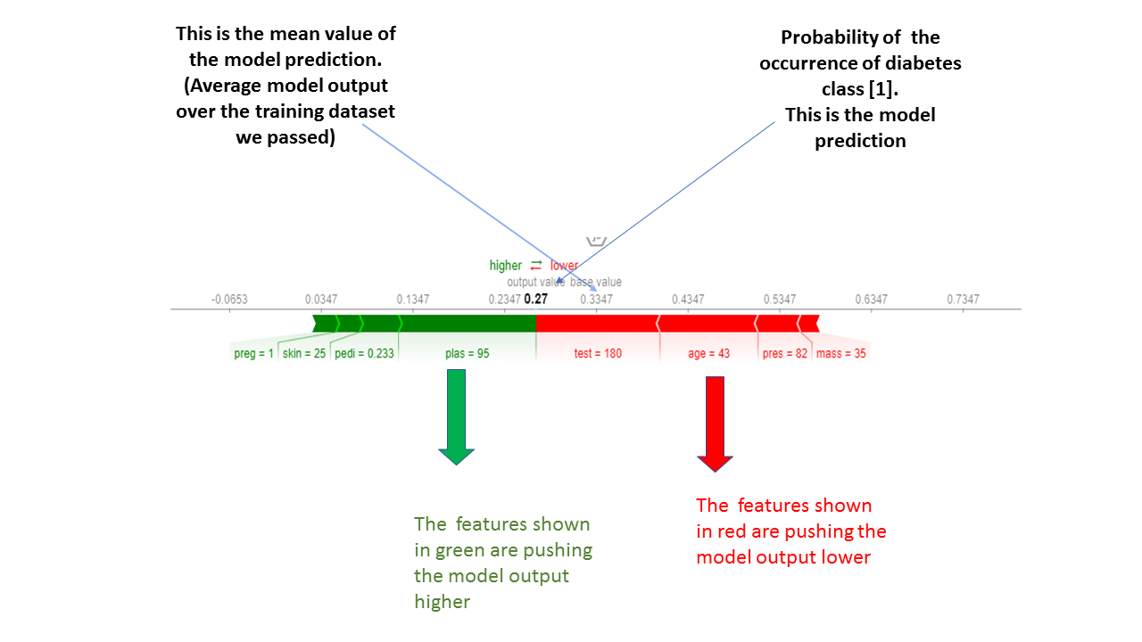
S
H
A
P
E
L
Y

Slide 10

Takeaways
Must acquire business and domain knowledge
Do not ONLY count on Accuracy
Focus on your Class of Interest
Interpret your model
Explain to business stakeholders its impact

Slide 11
Q&A

